Slide 1


Elham Fallah
9.1.2023
https://github.com/ElhamFallah23

Slide 2

Outline
Executive Summary
Introduction
Methodology
Results
Conclusion
Appendix

Slide 3
Executive Summary
Summary of methodologies
Introduction
Data Collection
Data Preprocessing
Feature Selection
Model Selection
Hyperparameter Tuning
Model Training
Evaluation Metrics
Results Interpretation
Summary of all results
Model Performance
Comparative Analysis
Predictive Power
Conclusion
Recommendations

Slide 4
Introduction
Project Overview: Space X Falcon 9 First Stage Landing Prediction
Project Background and Context:
SpaceX offers Falcon 9 rocket launches for $62 million on its website.
In contrast, competitors charge over $165 million per launch.
SpaceX's cost advantage stems from the ability to reuse the first stage of the rocket.
Determining successful first stage recovery is pivotal in estimating launch costs.
This information holds strategic importance, especially in competitive bidding scenarios.
Problems to Address:
Determine the probability of a successful first stage landing.

Slide 5

Section 1

Slide 6
Methodology
Executive Summary
Data collection methodology:
SpaceX API, Web scraping Falcon 9 and Falcon Heavy Launches Records from Wikipedia
Perform data wrangling
Data Cleaning - Data Transformation - Feature Engineering - Handling Outliers - Data Validation
Perform exploratory data analysis (EDA) using visualization and SQL
Perform interactive visual analytics using Folium and Plotly Dash
Perform predictive analysis using classification models
Build different classification models like Logistic Regression, Decision Trees, Random Forest, SVM, KNN
Use Automated Hyperparameter Tuning Library scikit-learn's GridSearchCV to tune hyperparameters
Evaluate models by different evaluation metrics like Accuracy, Precision, Recall, F1 score, ROC AUC

Slide 7
Data Collection
Collect SpaceX launch information either through:
By the SpaceX REST API, which offers comprehensive details on launches, including rocket specifications, payload details, launch and landing parameters, and mission outcomes, accessible via the API URL api.spacexdata.com/v4/
By scraping Falcon 9 launch data from Wikipedia using the Beautiful Soup.
SpceX API
API URL api.spacexdata.com/v4/, Returns SpaceX data in Json
Scraping
Scraping Falcon 9 launch data from Wikipedia using the Beautiful Soup library
Normalization and integration
Integrated data from two sources to align with a common schema or structure.

Slide 8
Data Collection – SpaceX API
Request and parse the SpaceX launch data using the GET request
Filter the dataframe to only include Falcon 9 launches

Slide 9
Data Collection - Scraping
Web scrap Falcon 9 launch records with BeautifulSoup:
Extract a Falcon 9 launch records HTML table from Wikipedia
Parse the table and convert it into a Pandas data frame
Request the Falcon9 Launch Wiki page from its URL
Extract all column/variable names from the HTML table header
Create a data frame by parsing the launch HTML tables

Slide 10
Data Wrangling
Data Cleaning:
Handling missing data by imputing values or removing rows/column
Standardizing data formats (e.g., converting date formats, ensuring consistent units).
Removing duplicate records.
Correcting typos and inconsistencies in categorical data.
Data Transformation: converting data into a suitable format for analysis
Scaling or normalizing numerical features to ensure they have similar ranges.
Encoding categorical variables using techniques like one-hot encoding or label encoding.
Aggregating or summarizing data to a higher level of granularity, such as grouping data by categories.
Feature Engineering: creating new features or modifying existing ones to enhance model performance
Creating new variables based on existing ones (e.g., calculating ratios or percentages).
Extracting information from text or timestamps.
Applying domain-specific knowledge to generate relevant features.
Handling Outliers
Data Validation: checking for logical errors or inconsistencies

Slide 11
EDA with Data Visualization
Histograms and Box Plots
To visualize the distribution and summary statistics of numeric variables in the dataset, helping to identify outliers, data skewness, and central tendencies
Scatter Plots
To visualize the spread and distribution of data, particularly for multiple categories or groups, allowing for comparisons and identifying potential outliers
Heatmaps
Bar Charts
Box-and-Whisker Plots
To examine the relationships between two numeric variables, facilitating the exploration of potential correlations or patterns in the data
To represent categorical data and count frequencies, making it easier to understand the distribution of categorical variables or compare different categories
To visualize the correlation matrix of numeric variables, helping to identify multicollinearity and understand relationships between variables

Slide 12
EDA with SQL
Distinct Launch Sites
Launch Sites Starting with KSC
NASA Payload Mass
Mean Payload Mass (F9 v1.1)
Successful Drone Ship Landings
Boosters with Payload Mass Range
Mission Outcomes Count
Highest Payload Mass Boosters
2017 Records: Compile records featuring month names, successful landings for ground pad booster versions, and the corresponding launch sites during the year 2017.
Landing Counts Ranking: Rank the successful landing counts in descending order between June 4, 2010, and March 20, 2017.

Slide 13

Section 2

Slide 14
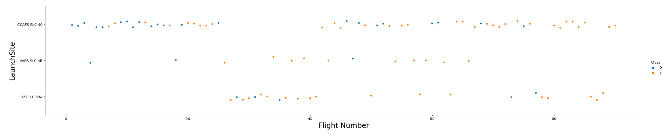
Flight Number vs. Launch Site
Scatter Plot
Three distinct groups within the launch site data were highlighted in the scatter plot, with successful launches depicted in orange (1) and unsuccessful launches in blue (0).

Slide 15
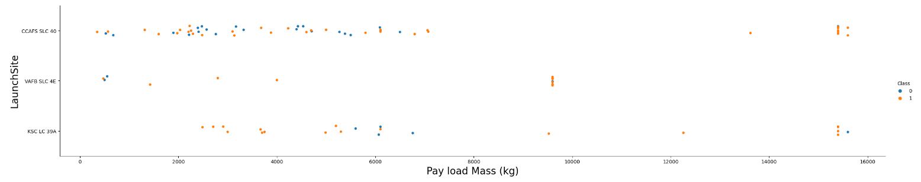
Payload vs. Launch Site
Scatter Plot
Three distinct launch site groups were analyzed based on their success outcomes (1 for Success in orange and 0 for Failure in blue) and visualized in a scatter plot.

Slide 16
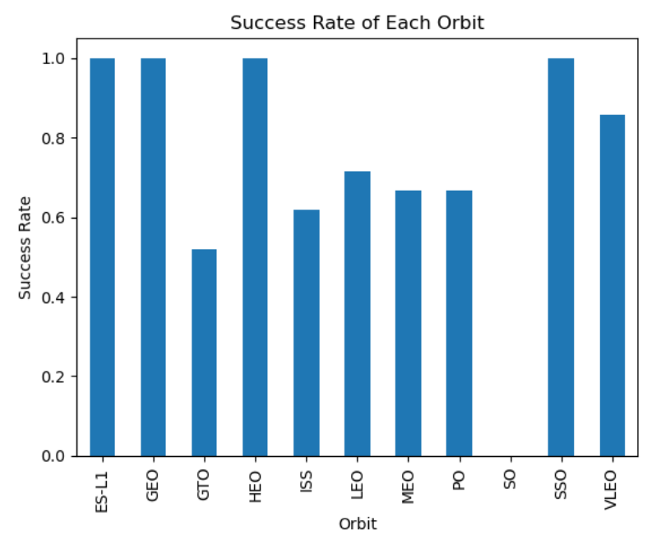
Success Rate vs. Orbit Type
Bar Plot

Slide 17
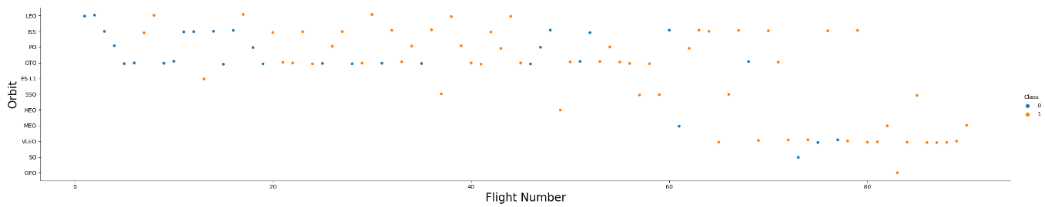
Flight Number vs. Orbit Type
Scatter Plot
The scatter plot reveals a notable trend: as the flight number increases within each orbit, the success rate generally rises, particularly in the case of Low Earth Orbit (LEO). However, it's worth noting that for Geostationary Transfer Orbit (GTO), there doesn't seem to be a clear correlation between these two factors.
Additionally, it's important to exclude orbits with only one occurrence from the aforementioned observation, as they require a more substantial dataset for meaningful analysis.

Slide 18
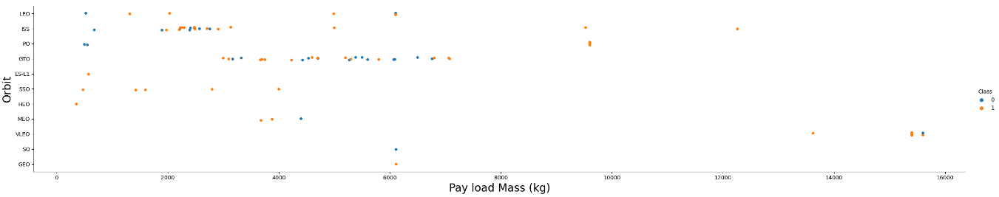
Payload vs. Orbit Type
Positive Impact on LEO and ISS: Increased payload weight has a favorable effect on Low Earth Orbit (LEO) and International Space Station (ISS) missions.
Negative Impact on MEO and VLEO: Conversely, heavier payloads have a detrimental impact on Medium Earth Orbit (MEO) and Very Low Earth Orbit (VLEO) missions.
No Clear Relation for GTO: Payload weight doesn't appear to show a distinct correlation with missions to Geostationary Transfer Orbit (GTO).
Insufficient Data for SOGEO and HEO: There isn't enough data available to discern any discernible patterns or trends for Sub-Orbital Geostationary Earth Orbit (SOGEO) and Highly Elliptical Orbit (HEO) missions.

Slide 19
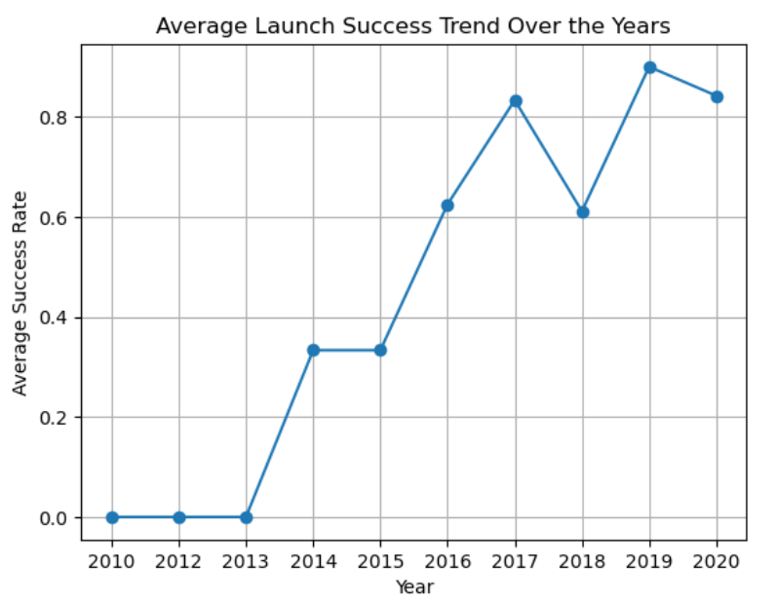
Launch Success Yearly Trend
The figures clearly show a consistent upward trend from 2013 to 2020.
If this trend continues in the coming years, the success rate will progressively rise until it reaches a perfect 100% success rate.

Slide 20
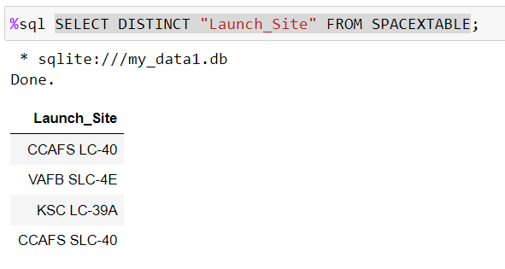
All Launch Site Names
There are three different Launch Site.

Slide 21
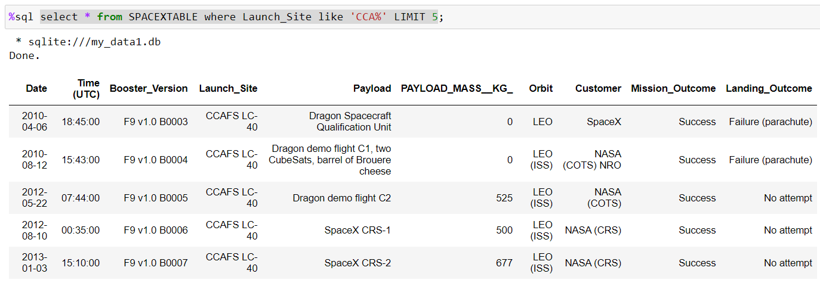
Launch Site Names Begin with 'CCA'

Slide 22
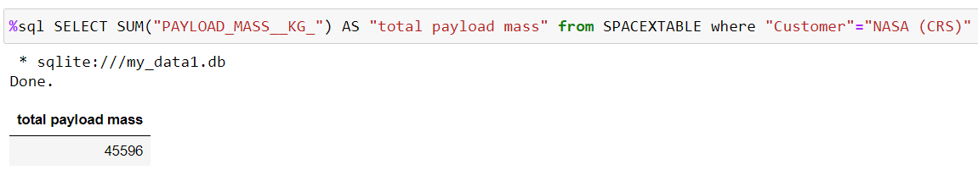
Total Payload Mass
The total payload mass carried by boosters launched by NASA (CRS):

Slide 23
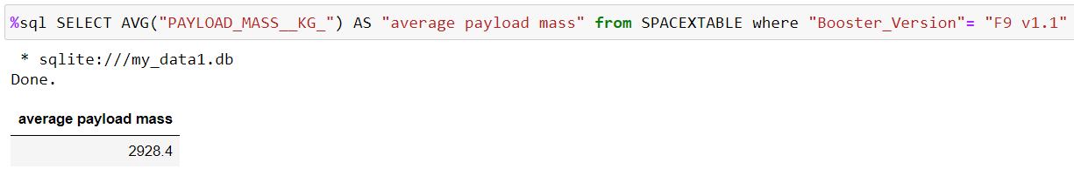
Average Payload Mass by F9 v1.1
Average payload mass carried by booster version F9 v1.1:

Slide 24
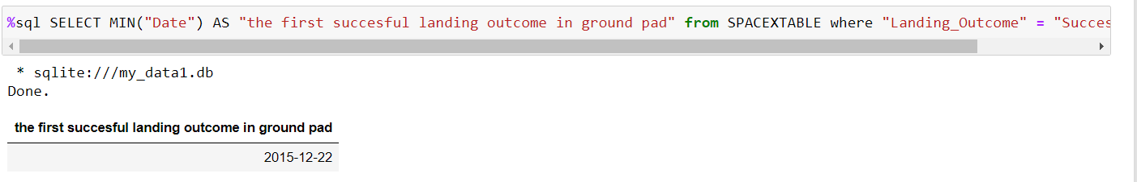
First Successful Ground Landing Date
The date when the first successful landing outcome in ground pad was achieved:

Slide 25
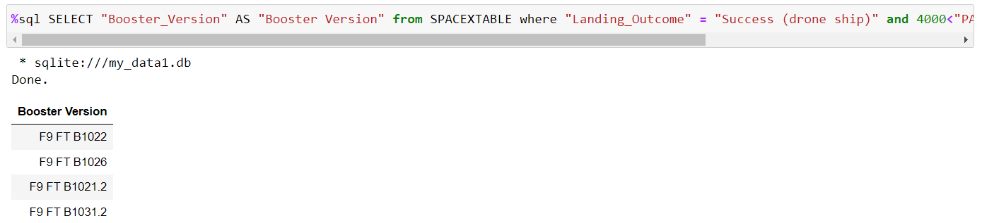
Successful Drone Ship Landing with Payload between 4000 and 6000
The names of the booster which have success in drone ship and have payload mass greater than 4000 but less than 6000:

Slide 26
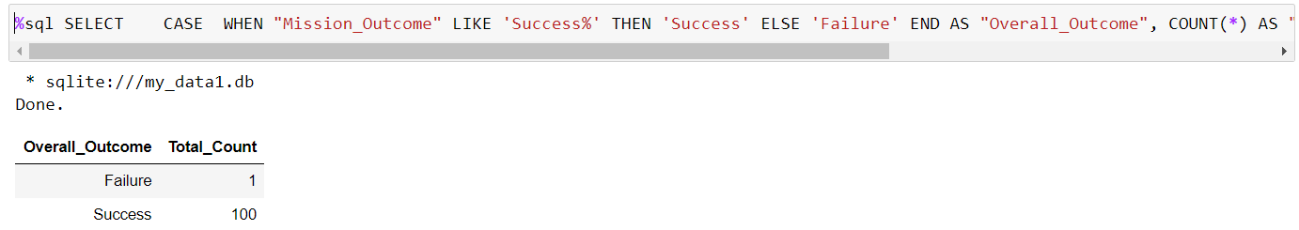
Total Number of Successful and Failure Mission Outcomes
The total number of successful and failure mission outcomes:

Slide 27
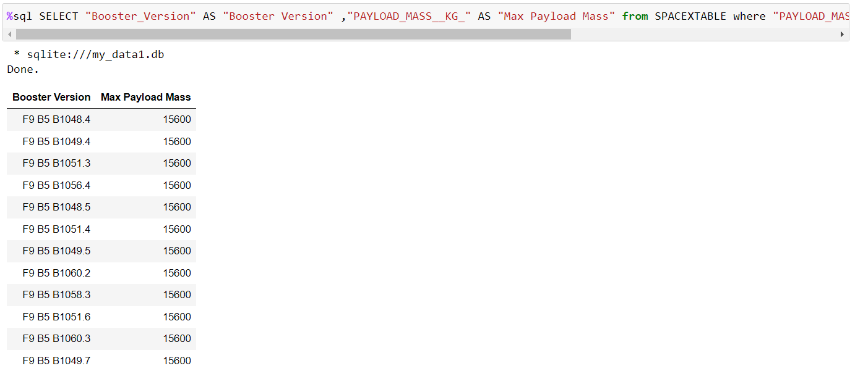
Boosters Carried Maximum Payload
The names of the booster versions which have carried the maximum payload masswith a subquery:

Slide 28
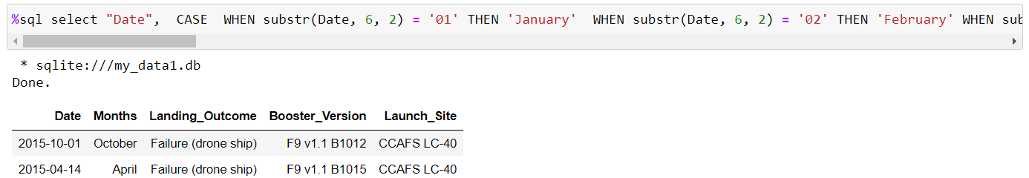
2015 Launch Records
The records which will display the month names, failure landing outcomes in drone ship, booster versions, launch site for the months in year 2015.

Slide 29
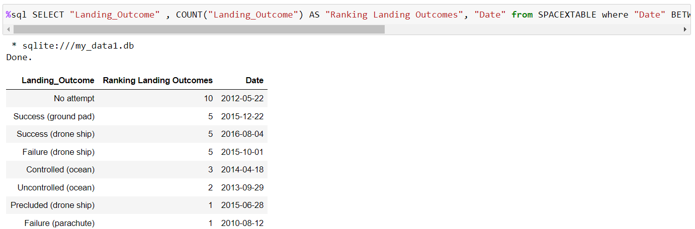
Rank Landing Outcomes Between 2010-06-04 and 2017-03-20
The count of landing outcomes (such as Failure (drone ship) or Success (ground pad)) between the date 2010-06-04 and 2017-03-20, in descending order

Slide 30

Section 3

Slide 31
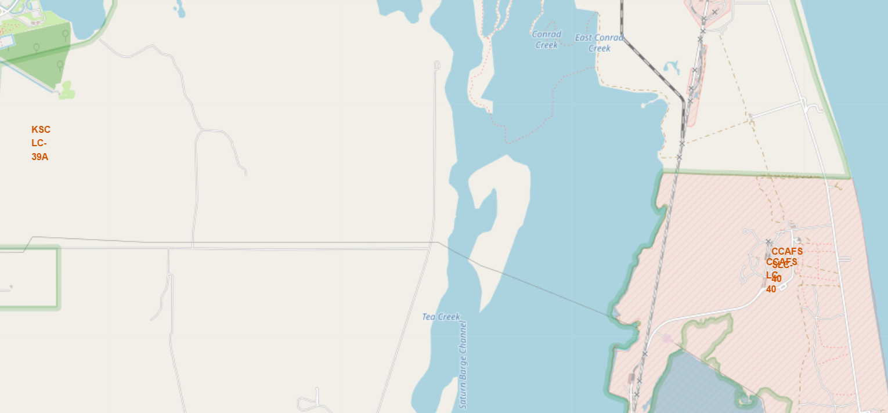
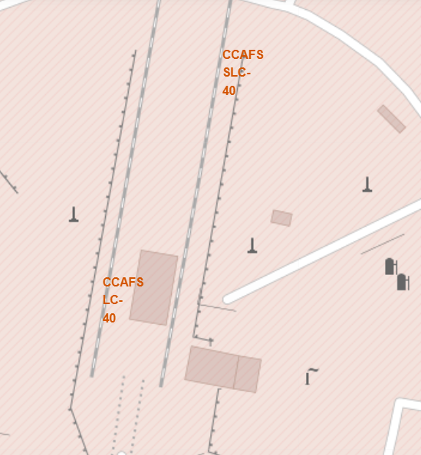
Mark all launch sites on a map
Previous coordinates are just plain numbers and not give any intuitive insights about where are those launch sites
Almost all the launch site are near to the coastline.

Slide 32
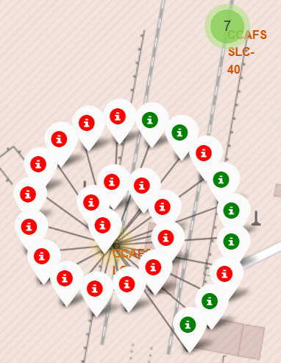
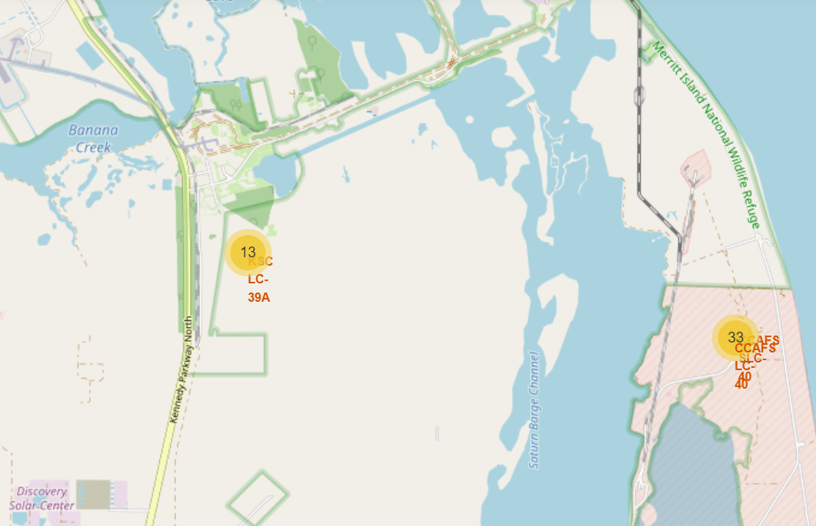
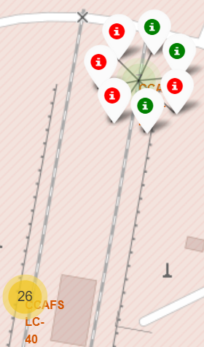
Mark the success/failed launches for each site on the map

Slide 33
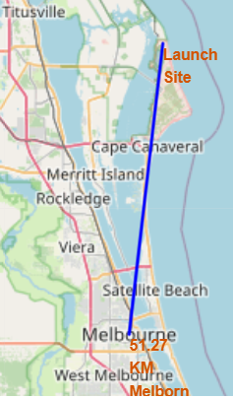
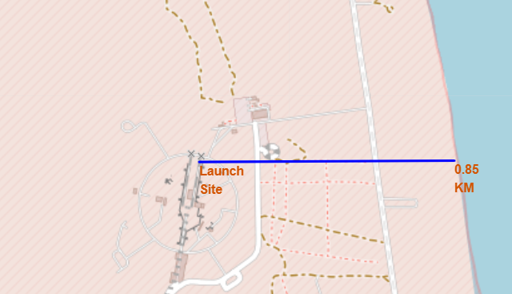
Calculate the distances between a launch site to its proximities
Distance between a launch site to the selected coastline point:
Distance between a launch site to the Melbourne city:

Slide 34

Section 4

Slide 35
Launch success count for all site
In the pie chart, both the proportion and count of successful launches are illustrated.

Slide 36
The launch site with highest launch success ratio
In the pie chart, the success ratio of each launch site is illustrated.

Slide 37
Payload vs. Launch Outcome scatter plot for all sites
In light of the scatter plot results, it is evident that CCAFS SLC 40 has the highest occurrence of both successful and failed launches, making it a launch site with the most mixed success rates.

Slide 38

Section 5

Slide 39
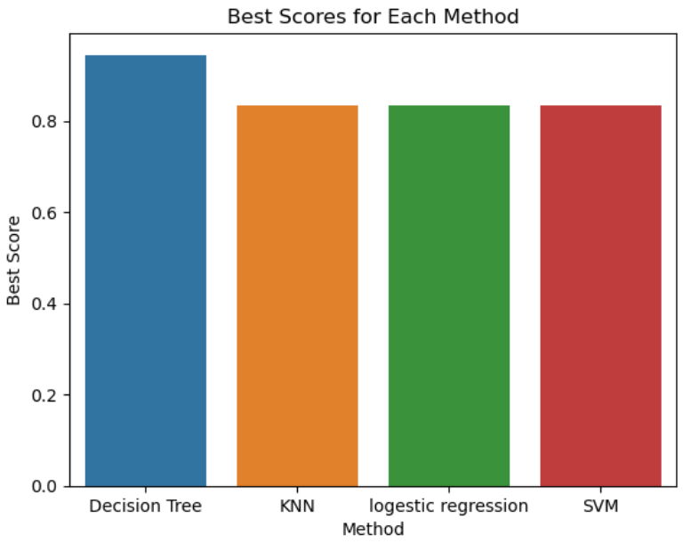
Classification Accuracy
The best-performing model, Decision Tree, achieved an accuracy of 94.44% on the confusion matrix.
Subsequently, SVM, Logestic Regression and k-Nearest Neighbors (KNN) exhibited similar performance rankings.

Slide 40
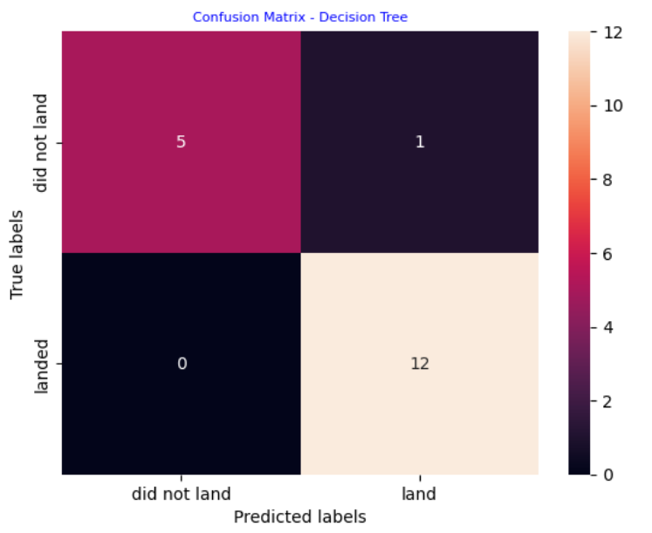
Confusion Matrix
The decision tree classifier's confusion matrix indicates its ability to differentiate between various classes.
However, a notable issue arises with false positives, where the classifier incorrectly identifies unsuccessful landings as successful ones.

Slide 41
Conclusions
Optimal Predictive Models: Logistic Regression, Support Vector Machines (SVM), Decision Trees (DT), and k-Nearest Neighbors (KNN) consistently deliver the most accurate predictions for this dataset.
Payload Weight Impact: Models perform better when predicting outcomes for lower weighted payloads, showing a preference for lighter payloads.
Improved SpaceX Launch Proficiency: SpaceX's launch success rates have shown a notable increase over the years, indicating an upward trend in launch proficiency.
Launch Site Success: KSC LC 39A emerges as the launch site with the highest number of successful launches, showcasing its reliability.
Orbital Categories: Orbital categories like GEO (Geosynchronous Orbit), HEO (Highly Elliptical Orbit), SSO (Sun-Synchronous Orbit), and ES L1 (Earth-Sun L1 Lagrange Point) exhibit the most favorable success rates among missions.

Slide 42


